Slide 1

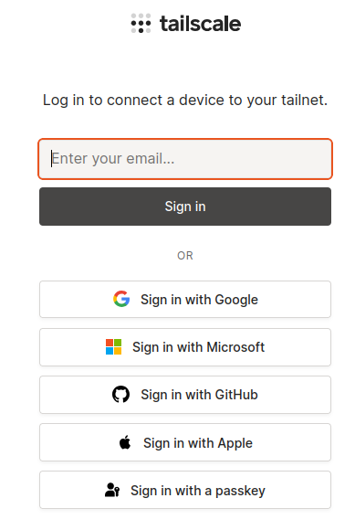
Week 1: SOC Setup & Log Ingestion
continue
4- installation of tailscale
We implement Tailscale to interconnect our systems via a secure Virtual Local Area Network (VLAN)
use Tailscale to link our devices together within a virtual private network

Slide 2
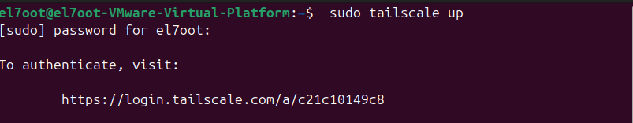
# To install Tailscale
1-open terminal and execute:
>> curl -fsSL https://tailscale.com/install.sh | sh
2-run tailscale
>> sudo tailscale up
Click on this URL

Slide 3
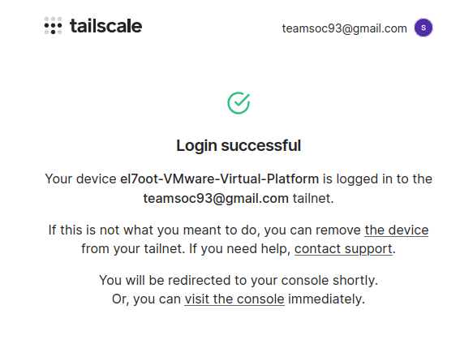
Tailscale loge in
Link account
username: teamsoc93@gmail.com
Password :123!@#123A
Now my device is logged in

Slide 4
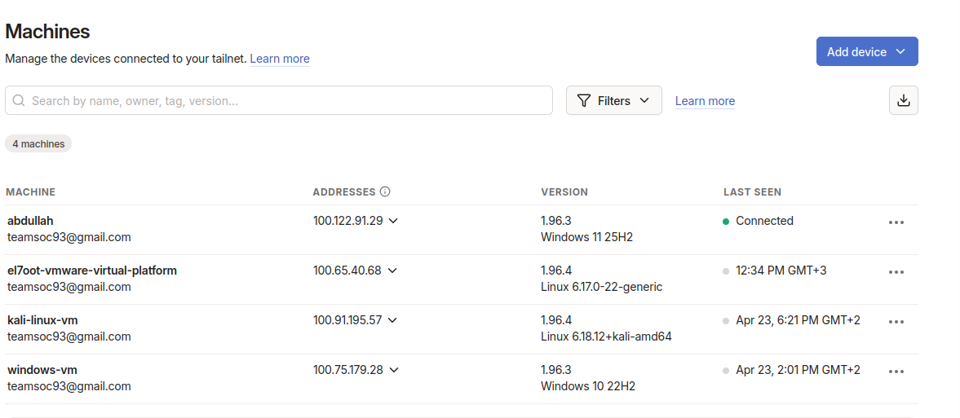
# You can see all devices in your environment

